Slide 1
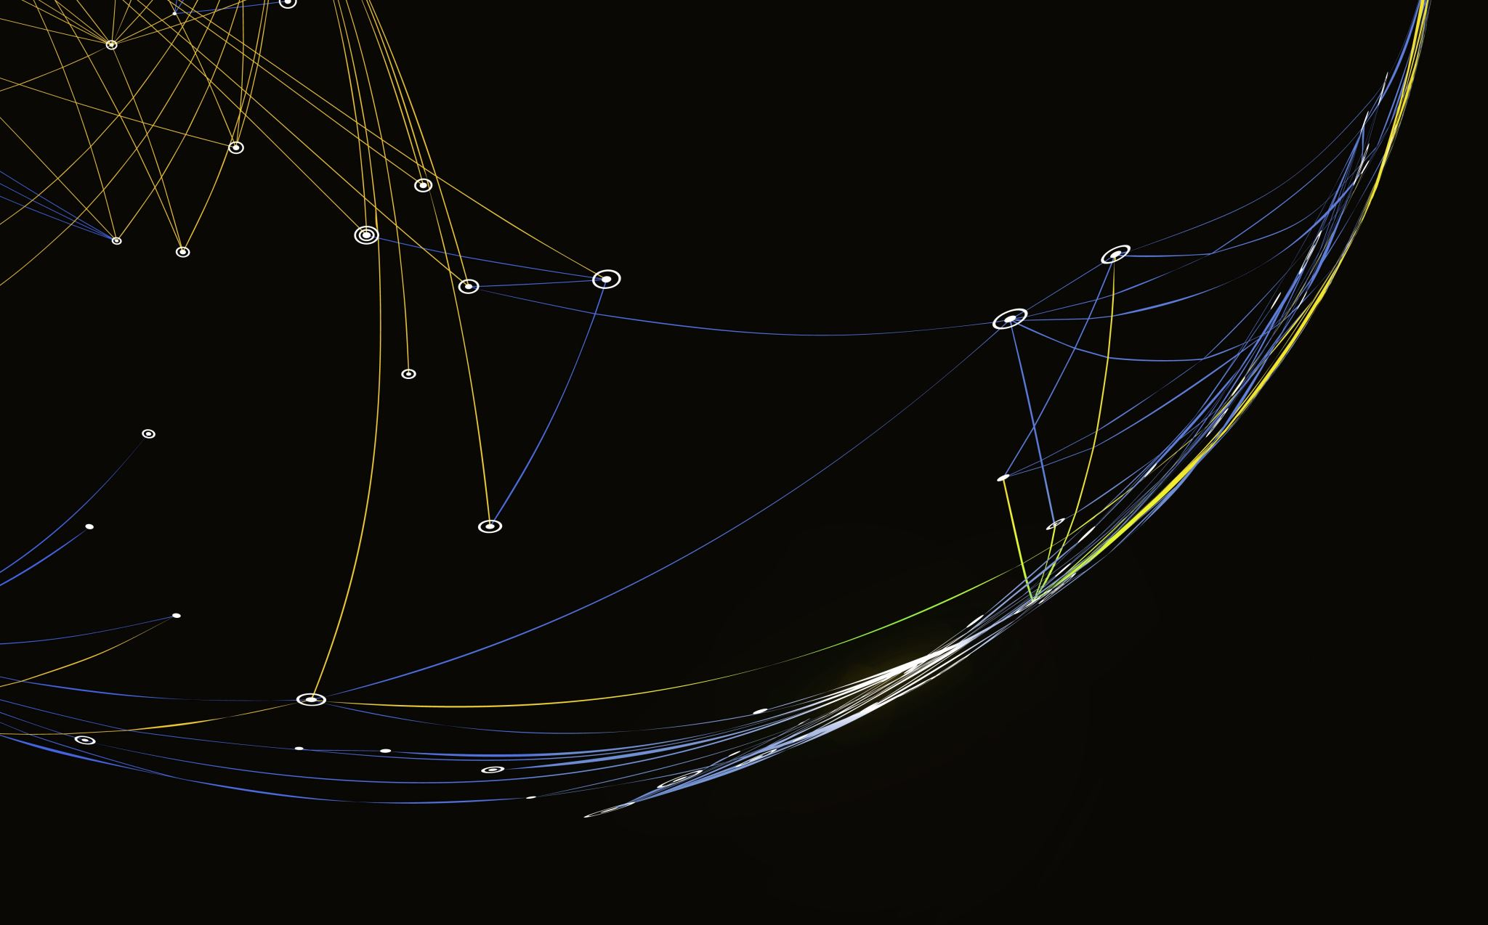
Spain Electricity Shortfall Challenge
Team 14

Slide 2

WEREN’T YOU A TEAM OF FIVE
EXACTLY

Slide 3

Table of Contents:
Introduction
Problem Statement
Exploratory Data Analysis (EDA)
Data Engineering
Model Performance
Conclusion

Slide 4

Introduction :
Spain considering expansion of its renewable energy resource.
Model shortfall between fossil and renewable resource energy.
Spain needs trends and patterns on energy generated.
Will renewable energy assist with minimizing energy shortfall.
Notes:
Spain has been struggling with the power consumption and its causing a shortfall in the country …
Spain considering expansion renewable energy resources because of the shortfall
Model shortfall between fossil fuel and ren
Trends and patterns
Will it assist with the shortfall or irradicate it

Slide 5


Problem Statement:
Tasked to model the shortfall between energy generated by fossil fuels and renewable sources for the country of Spain.
Energy Generated
Fossil Fuel
Renewable Sources
Shortfall

Slide 6

Exploratory Data Analysis:

Slide 7
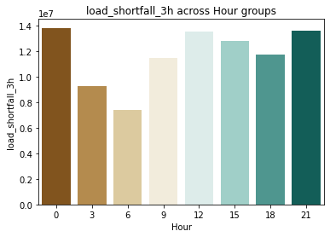
Load Shortfall during the day:
Load Shortfall Across Hour Groups
Load Shortfall
Hour
Notes:
Shows the shortfall from day to day
Mid day to midnight at its highest
Meaning people coming back from work
Not work hours
Demand in the afternoon is high …

Slide 8
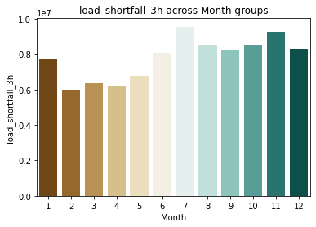
Load Shortfall During the year:
Load Shortfall Across Month Groups
Load Shortfall
Month
Notes:
Winter(DES-FEB) Spring(MAR-MAY) Summer(JUN-AUG) Autumn(SEP-NOV)
Shows us during summer autumn and start of winter the shortfall highest
Impacts businesses for air conditioners and shops with fridges and freezers and preserving their food

Slide 9
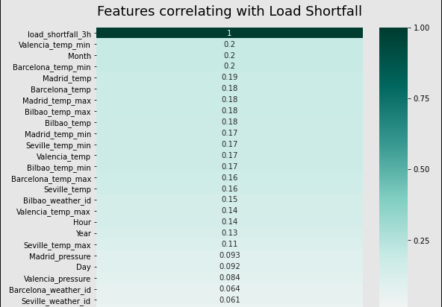
Features correlating Positive with load Shortfall graph:
Notes:
Shows features correlating positive
Means that it has an increasing affect
Madrid temp increases will increase shortfall
Reduce features
50 -38

Slide 10
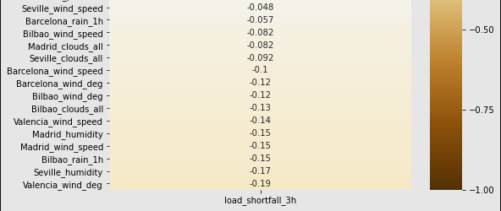
Features correlating Negative with load Shortfall graph:
Notes:
Opposite side of the spectrum affect is different
Features correlating negative
Meaning that it has an increasing affect when the feature decreases
Madrid wind s
Feature decreases the shortfall increases
Not full 50 features
Correlation between > 0,1 and -0,1 <
38 features validate our model
Reduce features

Slide 11

Data engineering
The data of 3 features were not in the correct format to be used for modelling.
Reformatted the 3 features from Object types to usable numerical data.
Created 4 new features (Hour, Day, Month Year) extracted from the Time feature.
One feature had null values, where we imputed the null values with the median.

Slide 12






Divide Dataset:
City Specific Weather
Load Shortfall
X = Features or independent variables.
Y = Dependent variable.

Slide 13

Standardization and why we used it:
Scaling technique that does not suffer from outliers and doesn’t contain it in a [0,1] range.
Why its important ?
Why not normalization ?
Suffer from outliers by squeezing data into [0,1] range making the bulk of the data lie in a small range.
Critical to regularization which puts constraints on the size of the coefficients related to each variable.

Slide 14
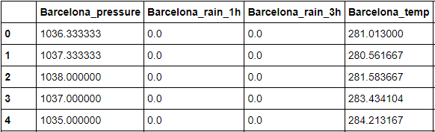
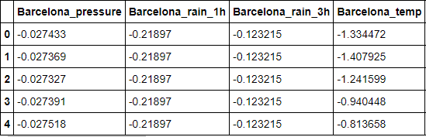
Data before and after standardization:
Before:
After:
Using standardization we rescale all the features to fit on the same scale, to make the regularization techniques more effective.

Slide 15
Root Mean Square Error (RMSE) :
Standard way to measure the error of a model in predicting quantitative data.
 | Decision Tree | KNeighbor- Regressor | Linear Regression | Ridge Regression | XGBooster Regressor
RMSE | 6187,23 | 4765,01 | 4848,57 | 4841,21 | 4361,64

Slide 16

XGBRegressor (Extreme Gradient Boosting) :
We used XGRegressor because of the Computation speed, Parallelization and Performance.
Scores better then individual models.
Scalable and accurate

Slide 17
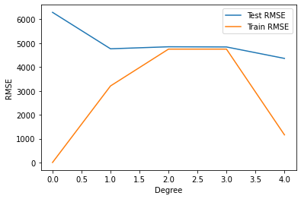

Model Performance:
Model Execution of 0,389 Seconds
RMSE value of 4361,64
0 = Decision Tree
1 = KNeighbors
2 = Linear
3 = Ridge
4 = XGB

Slide 18
Conclusion:
Date And Time | Load Shortfall
2018-01-01 03:00:00 | 7745,50
2018-01-01 09:00:00 | 8704,17
2018-01-01 15:00:00 | 12122,20
2018-01-01 21:00:00 | 15072,94
Date And Time | Load Shortfall
2018-12-31 03:00:00 | 8032,17
2018-12-31 09:00:00 | 10928,07
2018-12-31 15:00:00 | 12495,57
2018-12-31 21:00:00 | 14453,69
Avg per day = 10716,82
Avg per day = 11103,50

Slide 19
Weather Features:
City | Temperature
Barcelona | 0,998
Bilboa | 1,010
Madrid | 0,994
Seville | 1,051
Valencia | 1,011
City | Wind Speed
Barcelona | 1,214
Bilboa | 1,139
Madrid | 1,157
Seville | 1,066
Valencia | 1,371
City | Rain
Barcelona | 1,047
Bilboa | 1,632
Madrid | -
Seville | 1,487
Valencia | -

Slide 20
Extra Slides:

Slide 21
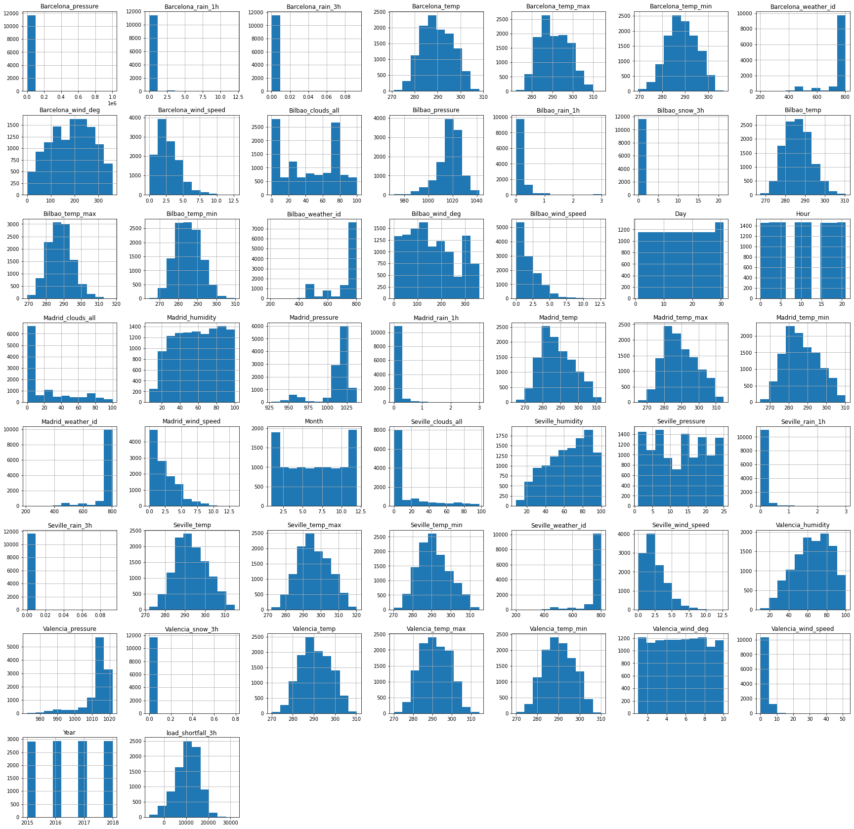
Histogram

